Slide 1
Quantum Computations
Seminar 3

Slide 2
Schedule
1. Introduction to Quantum Computing
2. Formalisms in QM & Computing
3. Quantum Circuits – Today
4. Fourier Analysis & Search Algorithms
5. Realisations of Quantum Computers
More to come…
I rescheduled the overall syllabus as now we require more time to explain concepts.

Slide 3
Before going in…
From now, we are entering the ‘real’ Quantum Computing.
Recall our first seminar? We shall prove many theorems and elaborate further on the topics I introduced at then.
It shall be little more technical and hard than before, but I think it will be transmittable.

Slide 4
Before going in…
Today, our content is based on chapters 4 on Nielsen & Chuang.
First, we go through algorithms and little more on Quantum Circuits.
I tried to incorporate some exercises. Harder exercises are explained, you must solve the easier ones.

Slide 5
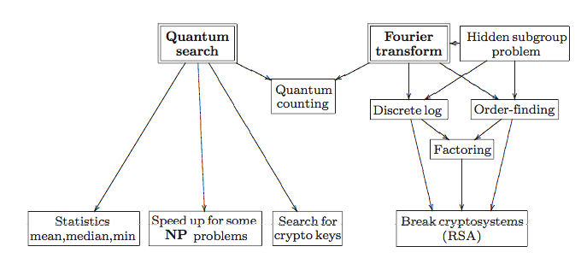
An Overview

Slide 6

Some Extra Gates
$X=\left[\begin{matrix}0 & 1 \\ 1 & 0\end{matrix}\right], Y=\left[\begin{matrix}0 & −i \\ i & 0\end{matrix}\right], Z=\left[\begin{matrix}1 & 0 \\ 0 & −1\end{matrix}\right]$
Think of the Pauli Spin Matrices.
Hadamard Gate $H=\frac{1}{\sqrt{2}}\left[\begin{matrix}1 & 1 \\ 1 & −1\end{matrix}\right]$
Phase Gate $S=\left[\begin{matrix}1 & 0 \\ 0 & i\end{matrix}\right]$
$π/8$ Gate $T=$ $\left[\begin{matrix}1 & 0 \\ 0 & e^{iπ/4}\end{matrix}\right]=e^{iπ/8}\left[\begin{matrix}e^{−iπ/8} & 0 \\ 0 & e^{iπ/8}\end{matrix}\right]$

Slide 7

Rotations of Quantum Gates
$R_{x}\left(θ\right)≡e^{−\frac{iθX}{2}}=cos\frac{θ}{2}I−isin\frac{θ}{2}X=\left[\begin{matrix}cos\frac{θ}{2} & −isin\frac{θ}{2} \\ −isin\frac{θ}{2} & cos\frac{θ}{2}\end{matrix}\right]$
$R_{y}\left(θ\right)≡e^{−\frac{iθY}{2}}=cos\frac{θ}{2}I−isin\frac{θ}{2}Y=\left[\begin{matrix}cos\frac{θ}{2} & −sin\frac{θ}{2} \\ sin\frac{θ}{2} & cos\frac{θ}{2}\end{matrix}\right]$
$R_{z}\left(θ\right)≡e^{−\frac{iθZ}{2}}=cos\frac{θ}{2}I−isin\frac{θ}{2}Z=\left[\begin{matrix}e^{−\frac{iθ}{2}} & 0 \\ 0 & e^{\frac{iθ}{2}}\end{matrix}\right]$
The Rotation operators rotate the state ket on the Bloch sphere. Check it!

Slide 8

Z-Y Decomposition for a Single Qubit
Theorem. Suppose U is a unitary operation on a single qubit. Then there exist real numbers α, β, γ and δ such that U = exp(iα)Rz(β)Ry(γ)Rz(δ).
Proof. The right hand side can be expressed as $U=\left[\begin{matrix}e^{i(α−\frac{β}{2}−\frac{δ}{2})}cos\frac{γ}{2} & {−e}^{i(α−\frac{β}{2}+\frac{δ}{2})}sin\frac{γ}{2} \\ e^{i(α+\frac{β}{2}−\frac{δ}{2})}sin\frac{γ}{2} & e^{i(α+\frac{β}{2}+\frac{δ}{2})}cos\frac{γ}{2}\end{matrix}\right]$
Since U is unitary and therefore the rows and columns are orthonormal, we can decide the four variables.
Should it be just Z & Y?

Slide 9
A Little Generalisation
We can generalise the axes and state that:
Suppose m and n are non-parallel real unit vectors in three dimensions.
U = exp(iα)Rn(β)Rm(γ)Rn(δ).
Corollary : Suppose U is a unitary gate on a single qubit. Then there exist unitary operators A, B, C on a single qubit such that ABC = I and U = exp(iα)AXBXC, where α is some overall phase factor.

Slide 10
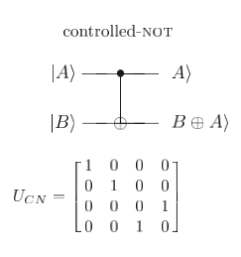

Controlled Operations
Matrix Representations: Remember this?
If the control qubit is set then U is applied to the target qubit, otherwise the target qubit is left alone; that is, |c⟩|t⟩ → |c⟩$U^{c}$|t⟩
(Generalisation)

Slide 11
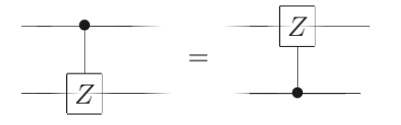
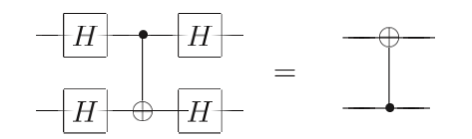
Exercises
1. Construct a gate from one controlled-Z gate, that is, the gate whose action in the computational basis is specified by the unitary matrix and two Hadamard gates.
2. Show
3. Flip of CNOT basis:

Slide 12
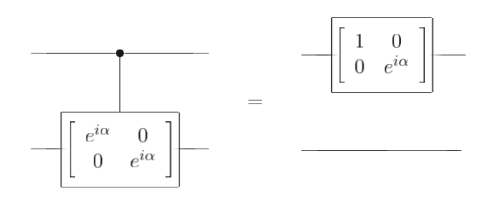
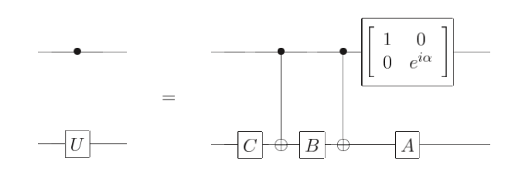
Construction of the Controlled-U Opeartions
Recall ABC = I and U = exp(iα)AXBXC
Also, we have to give the phase, which is not very hard as
From this,

Slide 13
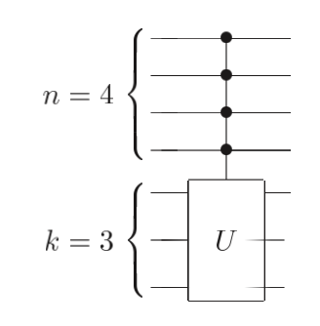

Conditioning of Multiple Qubits
$C^{n}\left(U\right)\left|\left.x_{1}x_{2}x_{3}…x_{n}\right\rangle \right.\left|\left.ψ\right\rangle \right.=\left|\left.x_{1}x_{2}x_{3}…x_{n}\right\rangle \right.U^{x_{1}x_{2}x_{3}…x_{n}}\left|\left.ψ\right\rangle \right.$
(More generally, suppose we have n + k qubits, and U is a k qubit unitary operator. )
For U to operate in the k target qubits, all slots in $x_{1}x_{2}x_{3}…x_{n}$ should be 1!

Slide 14
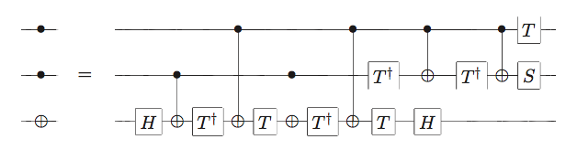
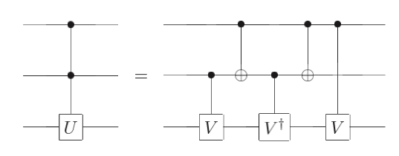
Construction of the Toffoli Gate
Doesn’t the content in the last slide REALLY imply that we can make Toffoli gates?
Actually, we can create all CCU Gates with just CNOT and single Qubit operations.
(You know what to do from here.)

Slide 15
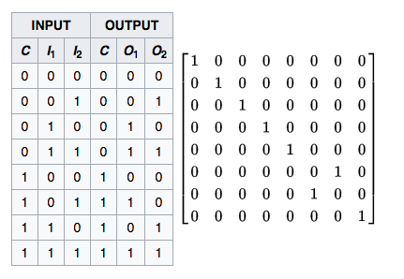
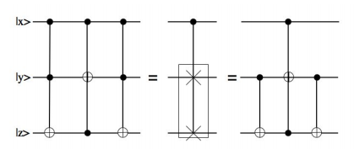
Fredkin Gates
Known as the CSWAP gate
1. Construct the Fredkin Gate using THREE Toffoli gates.
2. Actually, the first and third Toffoli can be replaced with CNOT.
3. More simply, we can just make this with 5 two-qubit operations.

Slide 16
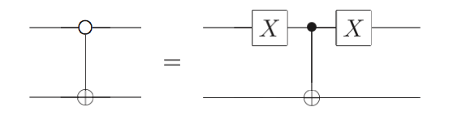
Conditional Dynamics when control qubit is 0
Until now, all the controlled operations were made only if the controlled qubits are 1.
Constructing the gates which operates if the conrolled qubits are 0 is quite useful!
Construction is easy:

Slide 17
Two Useful Theorems for Measurement
Principle of deferred measurement: Measurements can always be moved from an intermediate stage of a quantum circuit to the end of the circuit; if the measurement results are used at any stage of the circuit then the classically controlled operations can be replaced by conditional quantum operations.
Principle of implicit measurement: Without loss of generality, any unterminated quantum wires (qubits which are not measured) at the end of a quantum circuit may be assumed to be measured.

Slide 18
Universality
Recall seminar 1 and 2?
Some set of gates can create all algorithms by combination of their elements.
Our goal: CNOT gates and single qubit gates can create all quantum computer algorithms.

Slide 19
Two-Level Unitary Gates
Consider a unitary matrix U which acts on a d-dimensional Hilbert space.
U may be decomposed into a product of two-level unitary matrices; that is, unitary matrices which act non-trivially only on two-or-fewer vector components.
Considering for d=3 shall suffice the overall logic.

Slide 20

Two-Level Unitary Gates are Universal
Claim. We can construct $U_{1},U_{2},$ $U_{3}$ such that $I=U_{3}U_{2}U_{1}U$.
Proof. Set $U=\left[\begin{matrix}a & d & g \\ b & e & h \\ c & f & i\end{matrix}\right]$
If b=0, U1=I, else, $U_{1}=\left[\begin{matrix}\frac{a^{∗}}{\sqrt{{\left|a\right|}^{2}+{\left|b\right|}^{2}}} & \frac{b^{∗}}{\sqrt{{\left|a\right|}^{2}+{\left|b\right|}^{2}}} & 0 \\ \frac{b}{\sqrt{{\left|a\right|}^{2}+{\left|b\right|}^{2}}} & \frac{−a}{\sqrt{{\left|a\right|}^{2}+{\left|b\right|}^{2}}} & 0 \\ 0 & 0 & 1\end{matrix}\right]$
$U_{1}U=\left[\begin{matrix}a′ & d′ & g′ \\ 0 & e′ & h′ \\ c′ & f′ & i′\end{matrix}\right]$

Slide 21

Two-Level Unitary Gates are Universal
If c’=0, $U_{2}=\left[\begin{matrix}a^{′∗} & 0 & 0 \\ 0 & 1 & 0 \\ 0 & 0 & 1\end{matrix}\right]$ , else, $U_{2}=\left[\begin{matrix}\frac{a′}{\sqrt{{\left|a′\right|}^{2}+{\left|c′\right|}^{2}}} & 0 & \frac{c′}{\sqrt{{\left|a′\right|}^{2}+{\left|c′\right|}^{2}}} \\ 0 & 1 & 0 \\ \frac{c′}{\sqrt{{\left|a′\right|}^{2}+{\left|c′\right|}^{2}}} & 0 & \frac{−a′}{\sqrt{{\left|a′\right|}^{2}+{\left|c′\right|}^{2}}}\end{matrix}\right]$
$U_{2}U_{1}U=\left[\begin{matrix}1 & 0 & 0 \\ 0 & e′′ & h′′ \\ 0 & f′′ & i′′\end{matrix}\right]$
I think it is now quite straightforward how to construct $U_{3}$.

Slide 22
Gray Codes
A Gray code connecting s and t is a sequence of binary numbers, starting with s and concluding with t, such that adjacent members of the list differ in exactly one bit.
For instance, with s = 101001 and t = 110011 we have the Gray code 101001 101011 100011 110011.

Slide 23
Shortening the Unitary operator to Two-Level Unitary Gates
Implementing each step of the Gray code is easy: Use the controlled bit flip.
Stop just before the final step: By now, the remaining operation is a controlled one-qubit gate. We know that this can be implemented using CNOT and single qubit operations.
Then, just do the inverse process, and we are done.

Slide 24
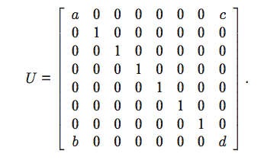
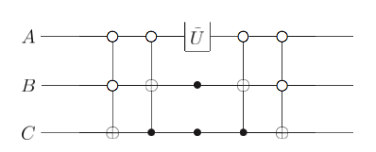

Example
Implement U.
$\tilde{U}=\left[\begin{matrix}a & c \\ b & d\end{matrix}\right]$
Note that only 000 and 111 gives non- trivial terms.

Slide 25

Approximation of Unitary Operators
A discrete set of gates can’t be used to implement an arbitrary unitary operation exactly, since the set of unitary operations is continuous.
A discrete set CAN be used to approximate any unitary operation.
Definition of Error: $E\left(U,V\right)=\max_{\left|\left.ψ\right\rangle \right.}\left\|(U−V)\left|\left.ψ\right\rangle \right.\right\|$, where U is the real operator and V is the approximated one.

Slide 26
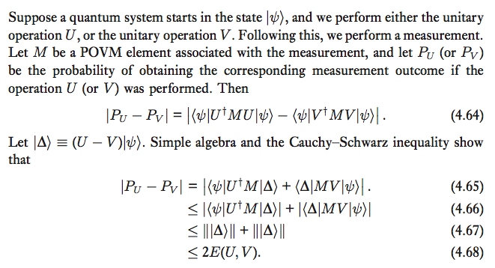

Approximation of Unitary Operators
What does this inequality mean?
Ans: If the error is small, the difference of probabilities in measurement outcomes are also small.
We CAN generalise this to n operators, and the result is:
$E\left(U_{m}U_{m−1}…U_{1},V_{m}V_{m−1}…V_{1}\right)≤\sum_{j=1}^{m}{E(U_{j},V_{j})}$

Slide 27

Some Additional Theorems
1. The standard set of gates, comprised of Hadamard, Phase, CNOT, and $\frac{π}{8}$ gates are universal.
Proof is made by picturing those gates at the Bloch sphere, which turns the gates into a rotation operators. We then use some $ε−δ$ technique to prove the theorem.

Slide 28

Some Additional Theorems
Solovay-Kitaev Theorem: An arbitrary single qubit gate can be approximated to an accuracy $ε$ requires $O(\log^{c}(1/ε))$ gates from our discrete set, where c is a constant approximately equal to 2.
This is a polylogarithmic increase over the size of the original circuit, which is likely to be acceptable for virtually all applications.

Slide 29

Simulation of Quantum Systems
Of course, this is possible in classical computers, albeit very inefficiently.
Schrodinger’s Equation: $i\frac{∂}{∂t}ψ\left(x\right)=(−\frac{1}{2m}\frac{∂^{2}}{∂x^{2}}+V\left(x\right))ψ\left(x\right)$
This means we have to solve exponential amounts of equations for many-particle systems…

Slide 30

Quantum Simulation Algorithm
$i\frac{∂}{∂t}\left|\left.ψ\right\rangle \right.=H\left|\left.ψ\right\rangle \right.$ ->$\left|\left.ψ(t)\right\rangle \right.=e^{−iHt}\left|\left.ψ(0)\right\rangle \right.$
Yeah..of course we can just approximate to the first order. But srsly, do you really think this will be accurate?
What we should do?: Let’s class Hamiltonians to many local interactions. $H=\sum_{k=1}^{L}{H_{k}}$
Each $H_{k}$ shall work on finite numbers (actually, usually two) of particles and therefore be quite easy to evaluate using Quantum Circuits. (i.e. $e^{−iH_{k}t}$ is much easier to evaluate than $e^{−iHt}$.)

Slide 31

Quantum Simulation Algorithm
Okay, but we do have some problems.
If $[H_{i},H_{k}]$ is NOT zero (which is the default), $e^{−iHt}≠\prod_{k=1}^{L}{e^{−iH_{k}t}}$
Trotter’s Formula: Let A and B be Hermitian operators. Then for any real t, $\lim_{n→∞}{{(e^{iAt/n}e^{iBt/n})}^{n}}=e^{i\left(A+B\right)t}$
I will not state the proof since it is little complicated, but one important consequence is $e^{i\left(A+B\right)Δt}=e^{iAΔt}e^{iBΔt}+O(∆t^{2})$

Slide 32
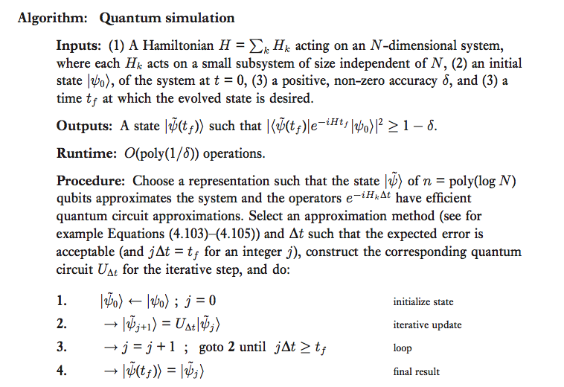
Quantum Simulation Algorithm

